Slide 1


Disaster Tweet Classification using NLP
DATA 255
San Jose State University
Prof Simon Shim
Dec 09, 2024
Team 04
Shrinivas Bhusannavar
Yashasvi Kotra
Monica Lokare
Karthik Nimmagadda
Harivardhana Naga Naidu Polireddi
Ravjot Singh

Slide 2


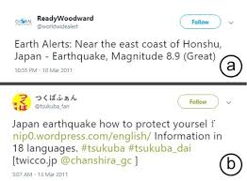

Project Introduction
Social media platforms like Twitter have transformed disaster reporting and response. However, distinguishing real disaster-related tweets from figurative or irrelevant ones is challenging. This project applies advanced Natural Language Processing (NLP) techniques, using models like LSTM, BERT, and RoBERTa, to classify tweets as disaster-related or not. By leveraging techniques like word embeddings and transformer architectures, the project aims to create a reliable solution for real-time disaster management and response.

Slide 3



Problem Statement
Objective: Develop a scalable model to classify tweets as disaster-related or non-disaster-related.
Challenges:
Extracting patterns from noisy, unstructured tweet data.
Capturing context to distinguish disaster-related tweets from irrelevant ones.
Maximizing accuracy and minimizing misclassification using advanced models.
Goal: Provide a reliable, automated solution for processing large-scale social media data during disasters, enabling faster response times and efficient resource allocation.

Slide 4
Significance
Real-Time Monitoring: Quickly identify disaster-related tweets to enable emergency responders to track events as they unfold.
Efficient Resource Allocation: Filter actionable information to direct resources to the most urgent locations.
Improved Decision-Making: Accurate tweet classification helps organizations prioritize interventions, reducing response times.
Community Safety: Enhances safety and well-being by streamlining critical information flow to affected communities.
Goal: Bridge the gap between unstructured social media data and actionable insights, supporting efficient and effective disaster response.

Slide 5


Related Work
1. Lakshmi Narayana U. (2023) - "Detecting Disaster Tweets using NLP"
Explores NLP’s role in disaster-related tweet classification.
Focuses on real-time disaster management and social media data processing.
Utilizes machine learning to extract critical information for disaster response.
2. Elhariri (2021) - "Introduction to NTL with Disaster Tweets"
Discusses NLP techniques to classify disaster-related tweets.
Highlights preprocessing steps: tokenization, stemming, and stopword removal.
Demonstrates supervised machine learning algorithms for efficient disaster response.
3. Biom MRA Model
An advanced NLP model for medical data analysis (Biomedicine).
Trained on multilingual datasets and optimized for low-resource devices.
Demonstrates NLP's growing influence in both disaster management and healthcare.

Slide 6
4. Altawaier & Tiun (2016) - "Arabic Twitter Sentiment Analysis"
Compares machine learning models (SVM, Naive Bayes, KNN) for Arabic sentiment
analysis.
Addresses challenges in analyzing dialect-rich languages like Arabic.
Emphasizes the importance of preprocessing (stemming, tokenization).
5. Liu et al. (2019) - "RoBERTa: A Robustly Optimized BERT Pretraining Approach"
Introduces RoBERTa, an enhancement to BERT with dynamic masking and larger
datasets.
Achieves state-of-the-art results in various NLP tasks.
Focuses on robust optimization for better model generalization.
6. Shukla et al. (2015) - "Sentiment Analysis on Tweets to Extract Emotions from Ambiguous Statements"
Proposes a methodology for handling ambiguous and sarcastic language in tweets.
Improves sentiment classification accuracy with feature extraction (n-grams, TF-IDF).
Focuses on emotion detection for social media analytics in real-world applications.

Slide 7
Project Scope
Data Source
Source: Kaggle: NLP Getting Started
Data Files:
train.csv: Labeled tweets (text, keyword, location, target)
test.csv: Unlabeled tweets for final submission
Target Variable: target (1 = disaster-related, 0 = not related)
Techniques Used:
Advanced machine learning and deep learning for classifying disaster-related tweets.
Embedding Creation:
GloVe: Pre-trained word embeddings.
BERT & RoBERTa: Contextual embeddings.
Model Training:
Models: LSTM, BERT, Optimized BERT (RoBERTa).
Evaluation:
Metrics: Accuracy, Precision, Recall, F1-Score.
Outputs: Classifies tweets as "Disaster-Related" or "Non-Disaster-Related."

Slide 8

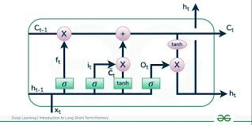
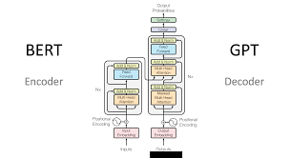
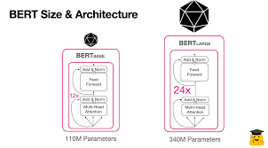
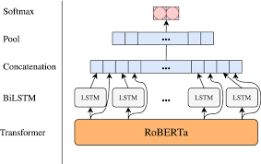
Proposed Solutions
LSTM (Long Short-Term Memory)
BERT
Advanced BERT
RoBERTa (Robustly Optimized BERT)
Captures sequential dependencies in text with memory cells.
Uses pre-trained GloVe embeddings for word representations.
Transformer-based architecture processing text bidirectionally.
Fine-tuned for task-specific performance.
Uses larger variants (e.g., bert-large-uncased).
Optimized hyperparameters for improved precision and recall.
Refines BERT with dynamic masking and removal of the next sentence prediction task.
Pre-trained on larger datasets for enhanced robustness and generalization.

Slide 9



Evaluation Metrics
We define appropriate metrics to assess the performance of our models, such as accuracy, precision, recall and F1 score. These metrics help us quantify the effectiveness of our solutions.

Slide 10

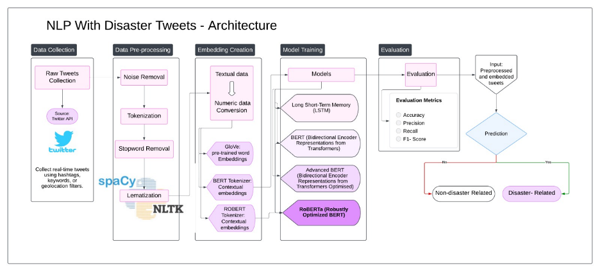
Project Architecture

Slide 11
Data Collection and Preprocessing
Data Collection
Source: Tweets collected via the Twitter API.
Method: Real-time collection using filters like hashtags, keywords, or geolocation parameters.
Objective: Capture disaster-related tweets, ensuring continuous, updated data to maintain relevance as events unfold.
Importance: Lays the foundation for further analysis by gathering raw, unfiltered data indicative of disaster-related activity.
Data Preprocessing
Cleaning: Removal of irrelevant elements (hashtags, mentions, URLs, special characters).
Tokenization: Breaking down the text into smaller units (words) for analysis.
Stop Word Removal: Filtering out commonly used words (e.g., "and," "the") to focus on key content.
Lemmatization: Reducing words to their base forms (e.g., "running" to "run") for consistency using NLTK and spaCy.

Slide 12
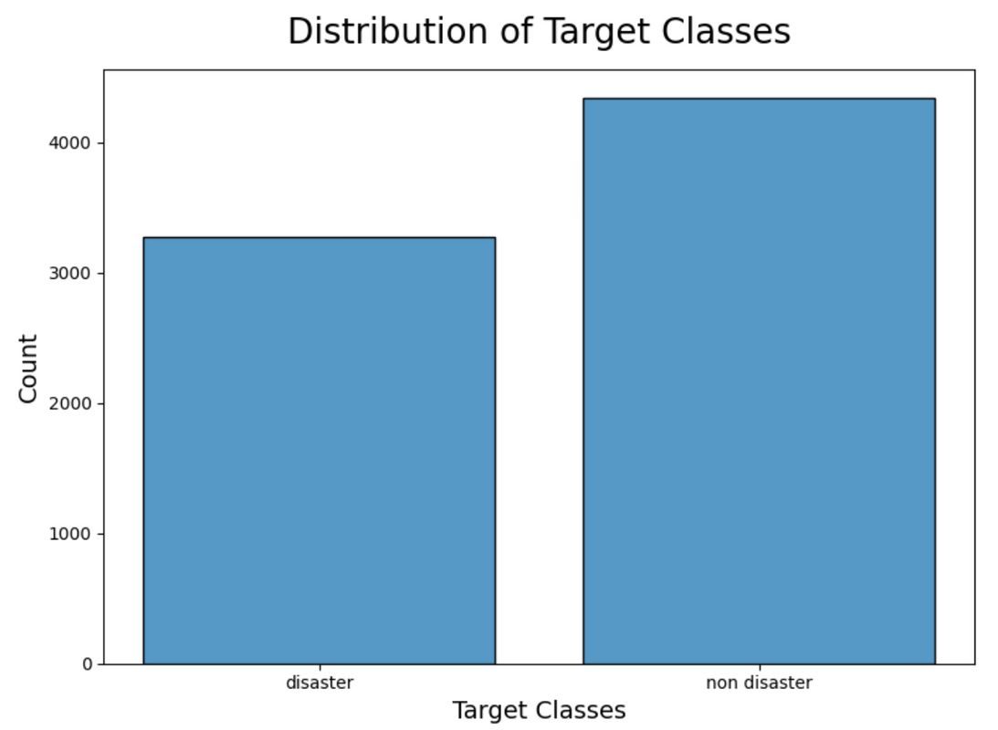
Exploratory Data Analysis (EDA)
Visualizing Target Class Distribution
The dataset showed a slight imbalance, with non-disaster tweets (57%) outnumbering disaster-related tweets (43%).

Slide 13
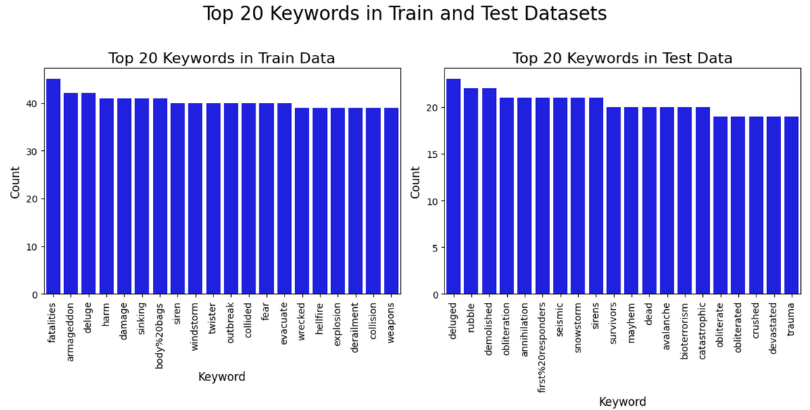
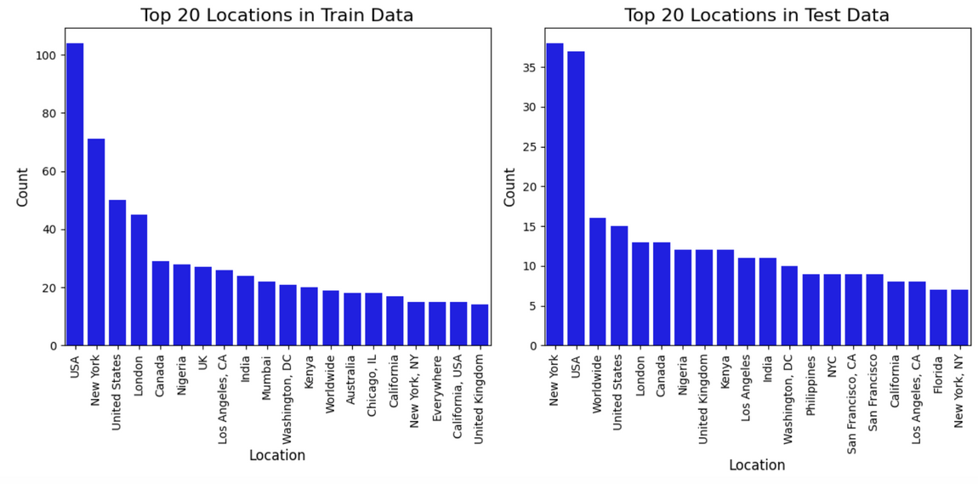
Visualizing Top Locations
Locations such as "USA," "New York," and "London" appeared frequently across both datasets.
Visualizing Top Keywords
Top keywords like "fatalities" and "armageddon" were more prevalent in disaster tweets, while common non-disaster terms included "youtube" and "content policy."

Slide 14
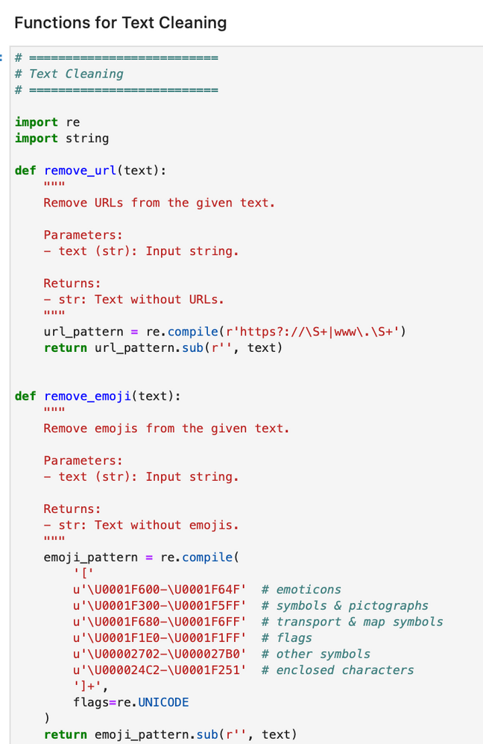
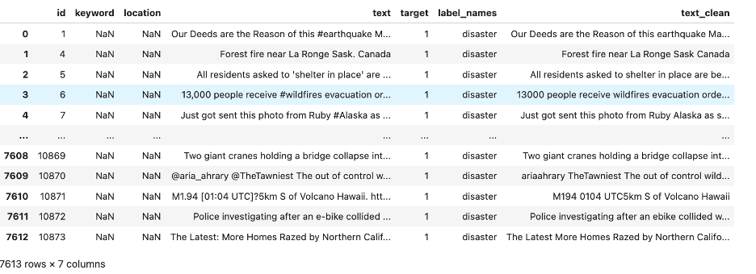
Data Cleaning
Text cleaning steps: Removed URLs, mentions, emojis, HTML tags, and punctuation. Text was lowercased for consistency. Stopwords were optionally retained for context in BERT-based models.

Slide 15
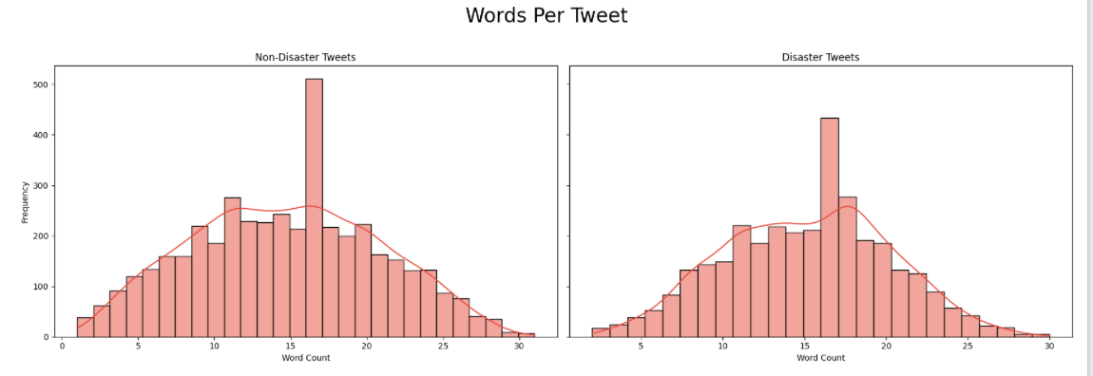
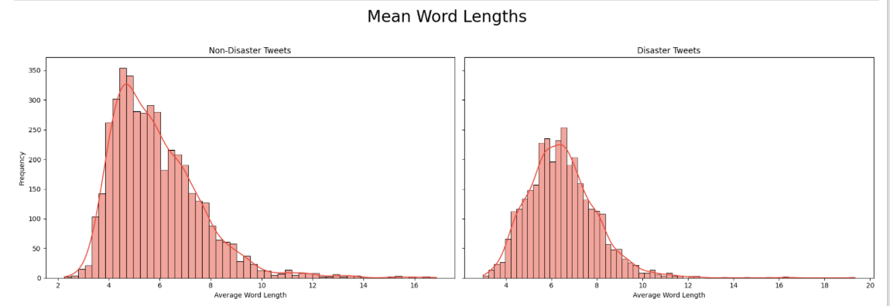
Words per Tweet
Side-by-side histograms of word counts show non-disaster tweets peaking around 15 words, reflecting concise communication. Disaster tweets have a broader distribution, indicating varied reporting styles.
Mean Words Lengths
Histograms of mean word lengths reveal disaster tweets have slightly longer words, hinting at specific or technical terms. Non-disaster tweets show more shorter words, reflecting casual language.

Slide 16
Feature Engineering
Preprocessing:
Raw tweets are cleaned by removing URLs, special characters, and irrelevant text (e.g., mentions, emojis).
Tokenization:
We use specialized tokenizers for each model, including WordPiece for BERT and GloVe embeddings for LSTM.
N-grams:
Unigrams, bigrams, and trigrams are extracted to capture important linguistic features that help distinguish disaster tweets from non-disaster ones.
Word Embeddings:
GloVe and BERT embeddings are utilized to represent words in vector space, capturing semantic and contextual relationships.

Slide 17
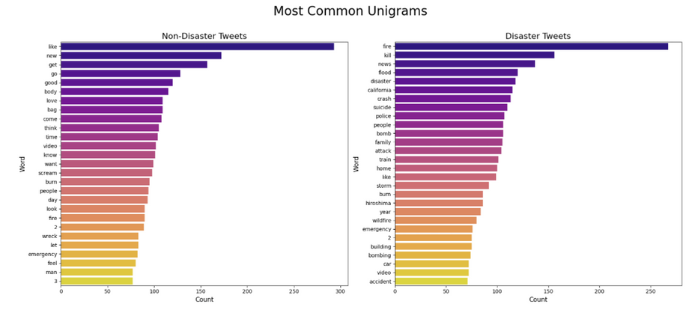
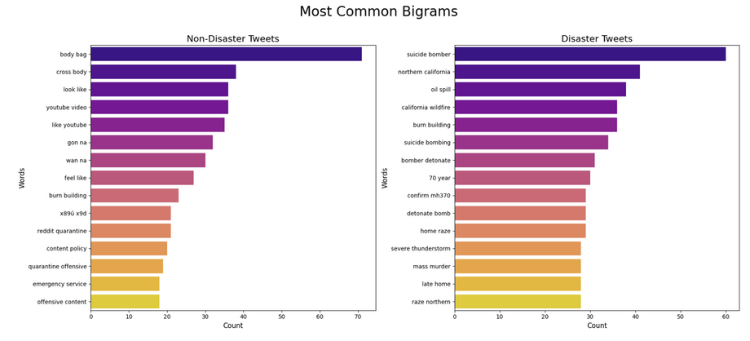
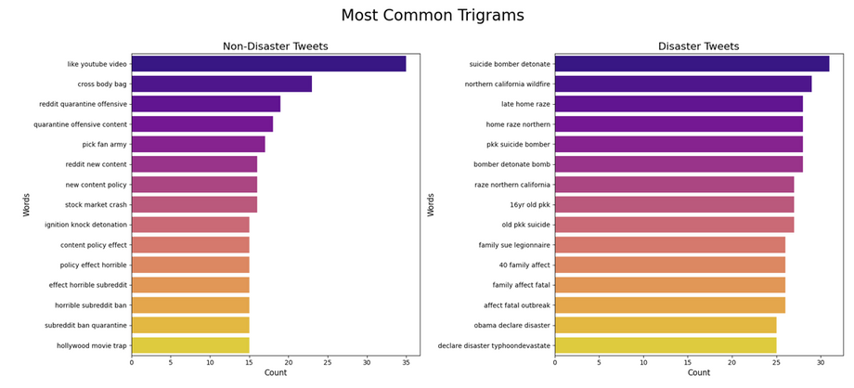
Unigrams
Disaster tweets prominently feature words like "fire," "flood," and "disaster," reflecting urgency and context. Non-disaster tweets frequently include casual terms like "like" and "new."
Bigrams
Common bigrams in disaster tweets include "suicide bomber" and "oil spill," while non-disaster tweets feature phrases like "body bag" and "look like."
Trigrams
Disaster-related trigrams often describe specific events (e.g., "suicide bomber detonate"), whereas non-disaster trigrams show colloquial expressions (e.g., "like youtube video").

Slide 18
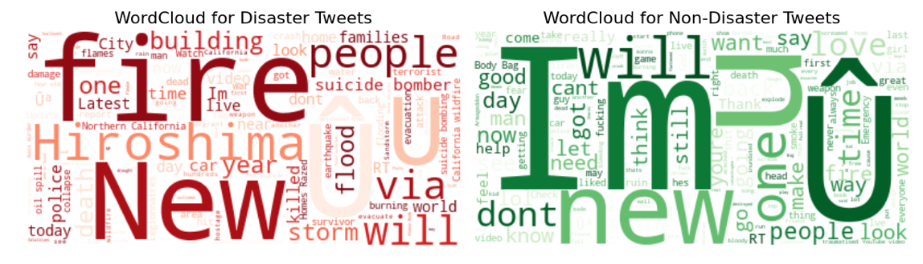
Word clouds reveal key themes: Disaster tweets highlight terms like 'fire,' 'suicide,' and 'death,' reflecting serious events. Non-disaster tweets feature casual words like 'love,' 'like,' and 'new.' These visuals offer a quick snapshot of tweet topics.
Word Clouds

Slide 19
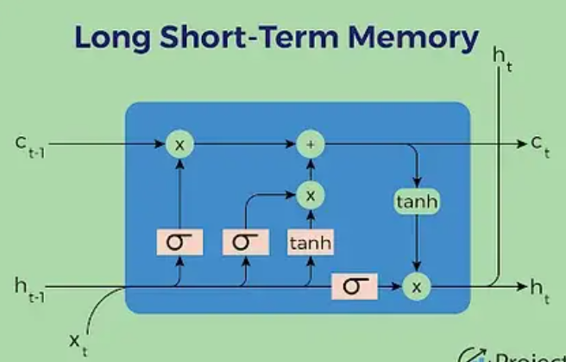
Model Development
Long Short Term Memory(LSTM)
Long Short-Term Memory (LSTM) is a type of Recurrent Neural Network (RNN) that resolves the vanishing gradient problem typical of earlier RNNs.
LSTM's gated architecture allows it to selectively remember or forget information across a sequence, making it ideal for tasks like sentiment analysis and text classification.
Architecture:
·Embedding Layer: Pre-trained GloVe embeddings (100-dimensional) were used to represent words semantically.
·LSTM Layer: A bidirectional LSTM with two layers captured both forward and backward dependencies in the input sequence, with a hidden state size of 128.
·Fully Connected Layer: A dense layer mapped the final hidden state to the output class for classification tasks.
·Dropout Layer: A dropout rate of 0.5 was applied to prevent overfitting.
Advanced BERT

Slide 20
Technical Overview:
The LSTM implementation relied on embedding pre-trained word vectors using models like GloVe.
The LSTM layer processed these embeddings to capture dependencies in the input text.
The architecture included a dropout layer to prevent overfitting, a fully connected layer to map the final hidden states to output labels, and an optional bidirectional setup to capture dependencies from both directions of the sequence.
Hyperparameters used
Hidden Dimension: 128
Embedding Dimension: 100
Number of LSTM Layers: 2
Bidirectional: Yes
Dropout Rate: 0.5
Batch Size: 32
Learning Rate: 0.001
Optimizer: Adam
Loss Function: Binary Cross-Entropy with Logits
Challenges:
While LSTM performed well for shorter sequences, it struggled with global context, often leading to a trade-off between accuracy and computational efficiency. Training LSTM on long text sequences was resource-intensive and required careful tuning to mitigate overfitting.

Slide 21
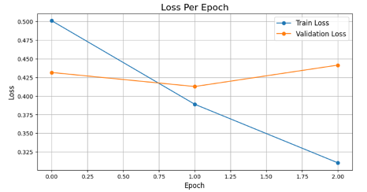
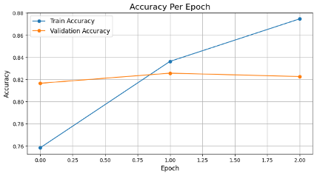
Visualizing metrics
LSTM Model Training:
Training is conducted for 3 epochs with a batch size of 32.
Binary cross-entropy loss is used as the objective function.
Adam optimizer with a learning rate of 0.001 facilitates parameter updates.

Slide 22
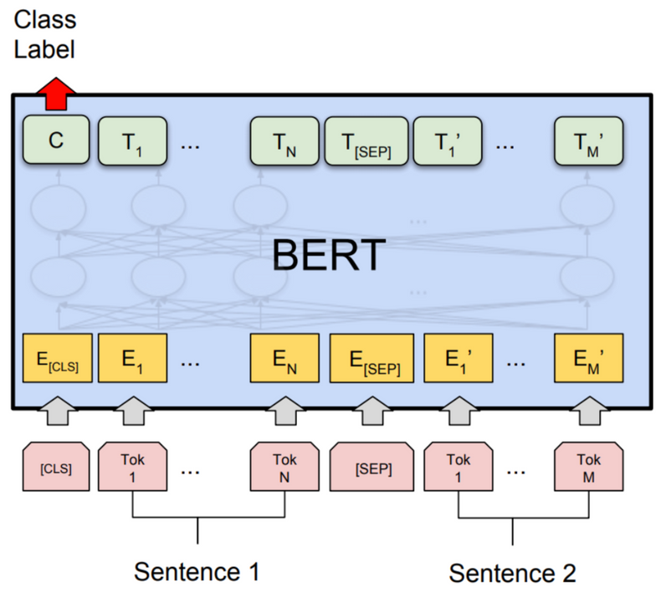
BERT
BERT (Bidirectional Encoder Representations from Transformers) transformed NLP by introducing bidirectional attention mechanisms.
Unlike LSTM, which processes sequences step-by-step, BERT looks at the entire sequence at once, leveraging Transformers' self-attention mechanism to weigh the importance of each word in the context of all others.
Architecture Details:
Base Model: The pre-trained bert-base-uncased model included 12 layers, 768 hidden units, 12 attention heads, and ~110M parameters.
Classification Head: A single linear layer processed the [CLS] token to predict binary labels.
Tokenization: Input text was tokenized into subwords using the BERT tokenizer, with [CLS] and [SEP] special tokens. Inputs were padded or truncated to a fixed length of 128 tokens.

Slide 23
Technical Overview:
BERT's architecture comprises multiple Transformer encoders, each consisting of self-attention layers and feed-forward networks.
Input embeddings are a combination of token embeddings, segment embeddings, and positional embeddings, ensuring that the model has a sense of word order and sentence segmentation.
The fine-tuning phase added task-specific dense layers to predict outputs for classification or regression tasks.
Hyperparameters:
Batch Size: 16
Epochs: 3
Learning Rate: 2×10^-5
Optimizer: AdamW
Gradient Clipping: Norm capped at 1.0
Sequence Length: 128 token
Challenges:
Switching to BERT introduced new challenges, particularly with computational requirements. The quadratic scaling of memory with input sequence length made it necessary to limit sequences to a maximum token length of 128 or 512.
Another challenge was understanding and adapting to WordPiece tokenization, which breaks words into subwords, complicating the preprocessing pipeline.

Slide 24
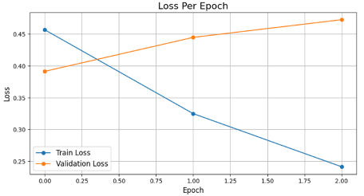
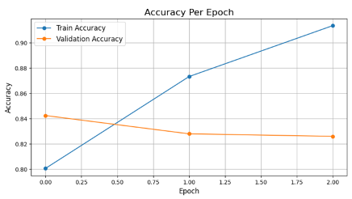
Visualizing metrics
BERT Model Training:
The pretrained BERT model is fine-tuned with a learning rate of 2e-5 for 3 epochs.
AdamW optimizer updates parameters, and a linear learning rate scheduler is used for gradual decay.
Gradient clipping (norm capped at 1.0) prevents exploding gradients.

Slide 25
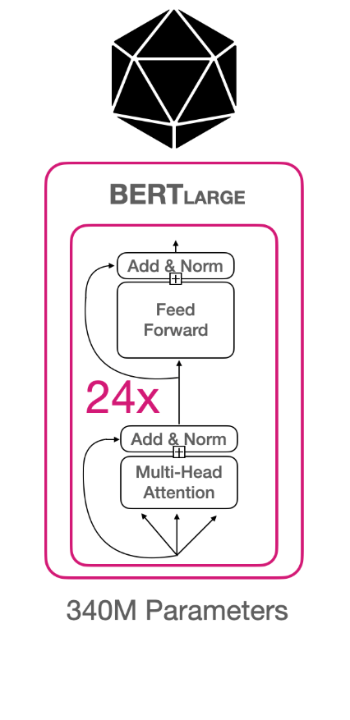
Advanced BERT
While BERT provided exceptional performance on general tasks, its architecture allowed for domain-specific fine-tuning, leading to what can be called Advanced BERT models.
These models are customized by pre-training or fine-tuning on datasets tailored to specific industries or problems.
Architecture Details:
Base Model: The pre-trained Bert-large-uncased model expanded to 24 layers, 1024 hidden units, 16 attention heads, and ~340M parameters.
Classification Head: A linear layer used the pooled output from the [CLS] token for binary classification.
Tokenization: Similar to BERT, but with inputs padded/truncated to a length of 84 tokens for task-specific optimization.

Slide 26
Technical Overview:
Advanced BERT models took BERT's capabilities further by employing larger architectures, task-specific fine-tuning, and optimized hyperparameters. This iteration focused on improving precision, recall, and F1 scores across complex datasets
Hyperparameters:
Batch Size: 32
Epochs: 3
Learning Rate: 6×10^-6
Optimizer: AdamW
Gradient Clipping: Norm capped at 1.0
Sequence Length: 84 tokens
Challenges:
Handling the large model size of Advanced BERT required GPU resources with higher memory capacities.
Moreover, fine-tuning required more time and careful tuning of parameters to achieve optimal results.
Training on domain-specific corpora required access to large, high-quality datasets.
Additionally, fine-tuning on tasks with limited labeled data risked overfitting, necessitating careful regularization and dropout configurations.

Slide 27
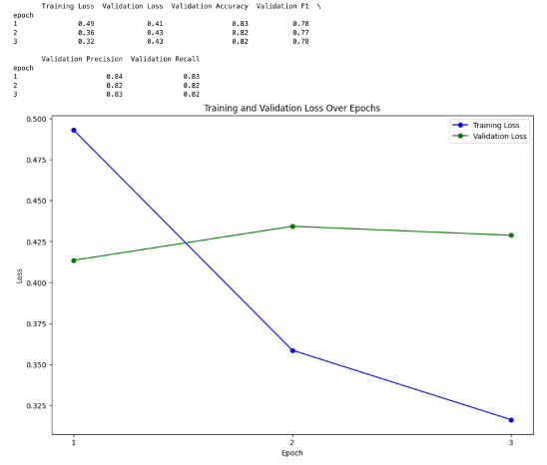
Visualizing metrics
Advanced BERT Training:
Fine-tuned with a learning rate of 6e-6 over 3 epochs using AdamW optimizer.
A linear learning rate scheduler with warm-up improves convergence.
Gradient clipping ensures training stability

Slide 28
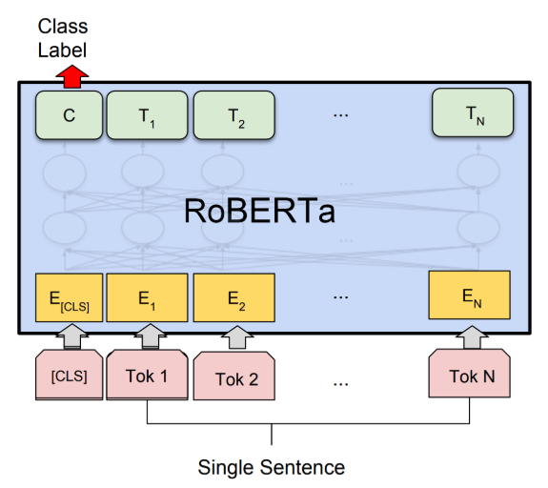
RoBERTa
RoBERTa is build on BERT's architecture which introduces key refinements.
RoBERTa removes the next sentence prediction objective used in BERT, instead focusing solely on masked language modeling with dynamic masking.
Architecture Details:
·Base Model: The roberta-base model retained the 12-layer transformer architecture but introduced dynamic masking and larger pre-training corpora.
·Classification Head: The pooled [CLS] token was passed through a dense layer for binary classification tasks.
·Tokenization: RoBERTa’s tokenizer dynamically masked inputs during pre-training, improving generalization.

Slide 29
Technical Overview:
RoBERTa retains the same core architecture as BERT but includes optimizations in training.
It dynamically masks tokens during training, ensuring that the model learns to generalize better across varying input patterns.
RoBERTa refined BERT by removing the next sentence prediction task, using dynamic masking during pre-training, and training on larger datasets with more extensive computational resources. These changes made RoBERTa more robust and better generalized.
Hyperparameters:
Batch Size: 16
Epochs: 3
Learning Rate: 1×10^-5
Optimizer: AdamW
Gradient Clipping: Norm capped at 1.0
Sequence Length: 128 tokens
Challenges:
Dynamic masking during fine-tuning added complexity to preprocessing pipelines. Achieving optimal performance required significant experimentation with batch sizes, learning rates, and other hyperparameters.
While RoBERTa delivered improved performance, the computational resources required for fine-tuning remained a major hurdle.
The model’s sensitivity to hyperparameters, such as learning rate and batch size, demanded extensive experimentation to achieve optimal performance

Slide 30
Visualizing metrics
Roberta Training:
Fine-tuned with a learning rate of e-6 over 3 epochs using AdamW optimizer.
A linear learning rate scheduler with warm-up improves convergence.
Gradient clipping ensures training stability.

Slide 31
Model Evaluation & Performance Comparisons
Model | Accuracy | Precision | Recall | F1 Score
LSTM | 0.80 | 0.76 | 0.79 | 0.77
BERT | 0.84 | 0.82 | 0.79 | 0.81
Advanced BERT | 0.84 | 0.85 | 0.84 | 0.83
RoBERTa | 0.84 | 0.85 | 0.84 | 0.80
Result Analysis
LSTM: Performs decently but struggles with long-term dependencies.
BERT: Shows substantial improvement in context comprehension and classification.
Advanced BERT & RoBERTa: Represent the state-of-the-art, with RoBERTa achieving the highest leaderboard ranking (59th out of 1007 participants).

Slide 32
Comparison Analysis
LSTM: While effective for handling sequential dependencies, LSTM's lack of bidirectional context comprehension limited its performance. Its accuracy (0.80) and F1-score (0.77) highlighted the need for more advanced architectures.
BERT: The introduction of bidirectional transformers significantly enhanced precision (0.82) and recall (0.79). BERT demonstrated its ability to process complex language structures, achieving a well-balanced F1-score (0.81).
Advanced BERT: Fine-tuning and larger model capacity allowed Advanced BERT to achieve consistent improvements across all metrics, particularly in recall (0.84) and F1-score (0.83).
RoBERTa: With its optimized training regimen and robust pre-training, RoBERTa achieved the highest precision (0.85) and recall (0.84). While its F1-score (0.80) slightly lagged behind Advanced BERT, it consistently performed well across all tasks, making it the most robust and generalizable model in this evaluation.

Slide 33
Rankings and Leaderboard Performance
LSTM Baseline
Initial LSTM attempts provided a baseline but struggled with context and bidirectional dependencies, resulting in modest leaderboard scores.(0.60 )
BERT Integration
BERT's bidirectional attention improved precision and recall, boosting leaderboard performance significantly. ( 0.74 )
BERT Optimization
Fine-tuning with optimized hyperparameters achieved a leaderboard score of 0.83297 (147/1007).
RoBERTa Leap
RoBERTa's robust training and larger datasets delivered the best score: 0.84033 (59/1007).

Slide 34
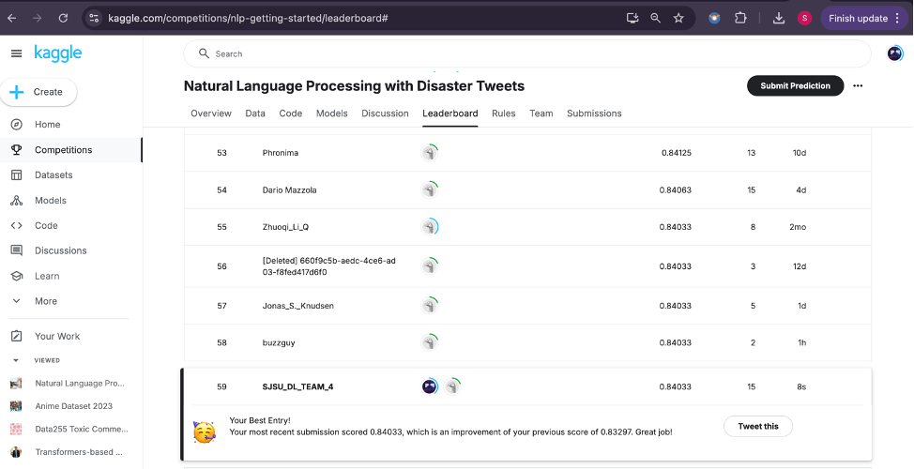
Rankings and Leaderboard Performance

Slide 35


Conclusion
The project demonstrated a clear progression from LSTM to RoBERTa, showing the evolution of model performance and capability in handling disaster tweet classification.
While LSTM laid the foundation for sequential data processing, BERT’s bidirectional attention mechanism significantly improved context understanding, leading to better precision and recall.
Advanced BERT fine-tuned the BERT architecture for better generalization, and RoBERTa's robust pre-training and dynamic masking further optimized performance, achieving the highest accuracy.
The models provide a scalable, reliable solution for real-time disaster monitoring and response, improving decision-making and response times in emergency situations.
With further improvements, these models could be adapted for multilingual disaster response systems, real-time classification, and integration with external data for comprehensive crisis management.

Slide 36
Future Work
Feature Expansion
Integrate tweet metadata and user information.
Extend multilingual tweet support for broader applicability.
Real-Time Capabilities
Implement real-time classification for live disaster monitoring.
Deploy a real-time monitoring system with automated emergency alerts.
Data Augmentation
Use back-translation or synthetic tweet generation to increase dataset diversity and address class imbalance.
Multi-Class Classification
Expand to categorize tweets into specific disaster types (e.g., wildfire, earthquake, flood).
Model Optimization
Explore smaller models like DistilBERT or ALBERT for faster inference on limited hardware.
Explainable AI
Use tools like SHAP or LIME to enhance model interpretability and trust for critical applications.

Slide 37

Thank You!

